Slide 1
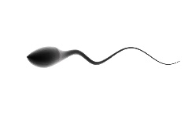
Primary oocyte arrested in prophase 1
Puberty
LH surge
The LH Surge has 3 main functions:
Initiate ovulation
Luteinize granulosa cells to start producing P
Activate the oocyte from its paused/arrested phase
The LH surge activates meiosis to extrude the first polar body and become a secondary oocyte.
M2-mature egg that is ‘fertilizable’
Meiosis 2 is completed when fertilization takes place. The second polar body is now extruded.
2 PN-earliest stage of an embryo (zygote)

