Slide 1

Female Infertility
Monica Moore, MSN, RNC
©Fertile Health, LLC

Slide 2
Objectives
Describe female anatomy and basic female reproductive function.
List the major hormones involved in female reproduction.
Describe the main causes of female infertility.
Explain what happens to a woman’s fertility potential as she gets older.
Describe common diagnostic tests used to determine the causes of female fertility.
List common treatment options available.

Slide 3
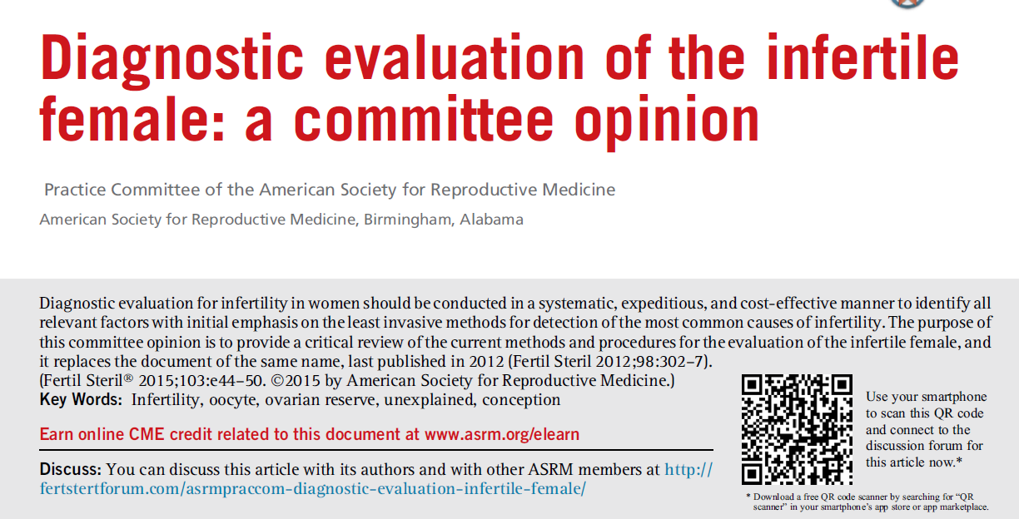
Fertil and Sterility, June 2015 (103), e44-e50.

Slide 4
Infertility-What is it?
Generally defined as inability to conceive a child after one year of unprotected intercourse
  Approx 85% of couples will achieve pregnancy within this time interval
Earlier evaluation in women:
  Over 35 years
  History of oligo/amenorrhea
  Known or suspected uterine/tubal disease or stage III-IV endometriosis
  Known or suspected male subfertility
Practice Committee of ASRM. Fertil Steril 2015(103) e44-e50.
Notes:
Infertility is defined as the inability to conceive a child after one year of unprotected intercourse
Earlier evaluation and treatment may be indicated in women who are
Over the age of 35
Oligo or amenorrheic
Known or suspected to have uterine or tubal disease or endometriosis
Reference: Practice Committee of ASRM. Fertil Steril 2006;86(suppl 4):S264

Slide 5
Time to Conception
Speroff L, Glass RH, Kase NG, editors. Clinical Gynecologic Endocrinology and Infertility. 7th ed. Baltimore Williams & Wilkins, 2005
Notes:
It is important to remind couples that in each ovulatory cycle ~30% of normal couples have a chance at becoming pregnant
After 3 months, the chance increases to close to 60%, and after 2 years, over 90% of normal couples will achieve pregnancy
Reference: Speroff L, Glass RH, Kase NG, editors. Clinical Gynecologic Endocrinology and Infertility. 7th ed. Baltimore Williams & Wilkins, 2005

Slide 6
Female Fertility-Basic Principles
HPO Axis needs to be functioning properly
Uterus needs to be receptive to hormonal stimulation and implantation
  Cervix needs to “allow” entry of sperm (and prevent bacteria from entering uterus)
Ovaries need to have viable follicles that respond to hormonal stimulation and ovulate
  If not doing IVF, fallopian tube(s) need to be patent

Slide 7
Ovulatory factor

Slide 8
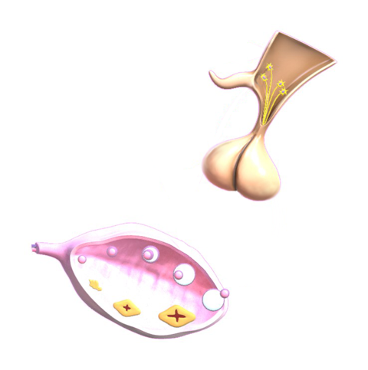
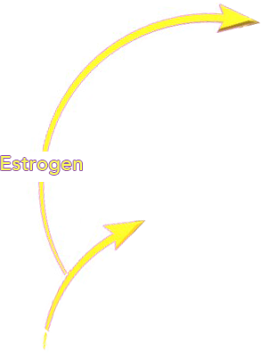
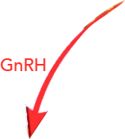
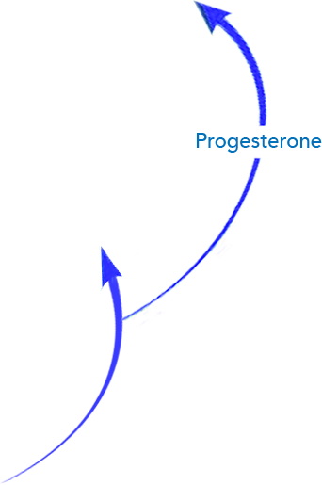



Slide 9
Impact of Age on Fertility

Slide 10

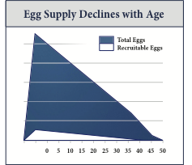
“Recruitable” Eggs-Egg Supply
Declines with Age.
Reproductive Aging

Slide 11
Fritz, Marc A.; Speroff, Leon
Title: Clinical Gynecologic Endocrinology and Infertility, 8th Edition
Copyright ©2011 Lippincott Williams & Wilkins

Slide 12
Cytoplasmic Aging
Maternal environment (particularly aging) has strong impact on the quality of cytoplasmic maturation and success of IVF
  Mitochondria are a critical example-cell division is ‘hard work’

Slide 13
Causes of infertility

Slide 14
Causes of Infertility
Fritz, Marc A.; Speroff, Leon
Title: Clinical Gynecologic Endocrinology and Infertility, 8th Edition
Copyright ©2011 Lippincott Williams & Wilkins

Slide 15
Pelvic factors

Slide 16
Endometriosis
Parts of endometrium migrate to other areas in pelvis and still respond to hormones, but are “stuck”: can’t exit body.
  Cause inflammation, pain, subfertility
Distortion of anatomy. “Toxic” substances in pelvis
No cure, tx options to relieve symptoms and prevent damage.
Continuous OCPs, aromatase inhibitors, GnRH agonists (create a hypoestrogenic state)
  Stop ovulation and alleviate pain
Laser ablation and resection of Stage 3 and 4 (grading system correlates with disease severity, not pain level)
Stage 1 and 2: Either Clomiphene / IUI or laser ablation (similar pregnancy rates)

Slide 17
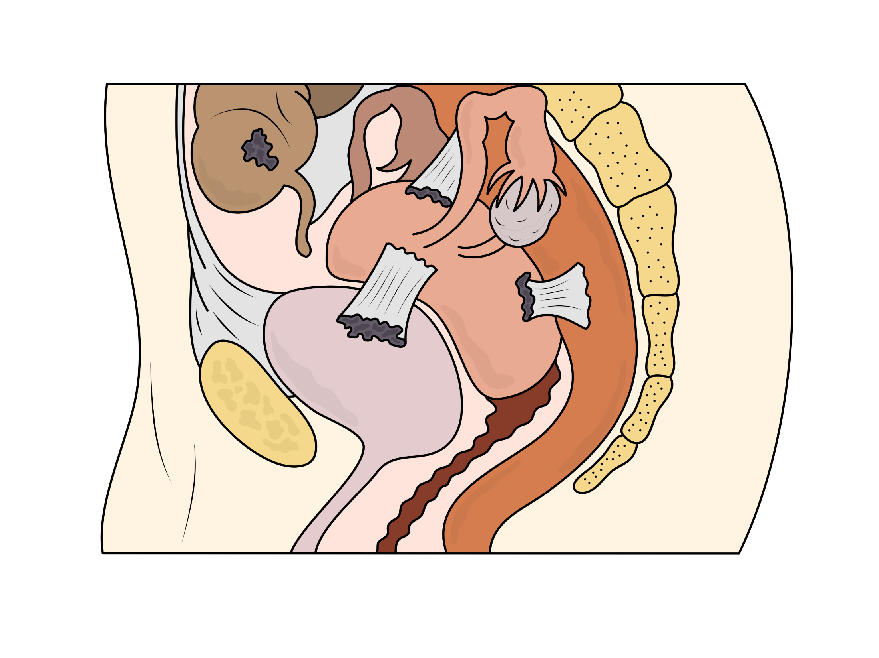
Endometriosis

Slide 18
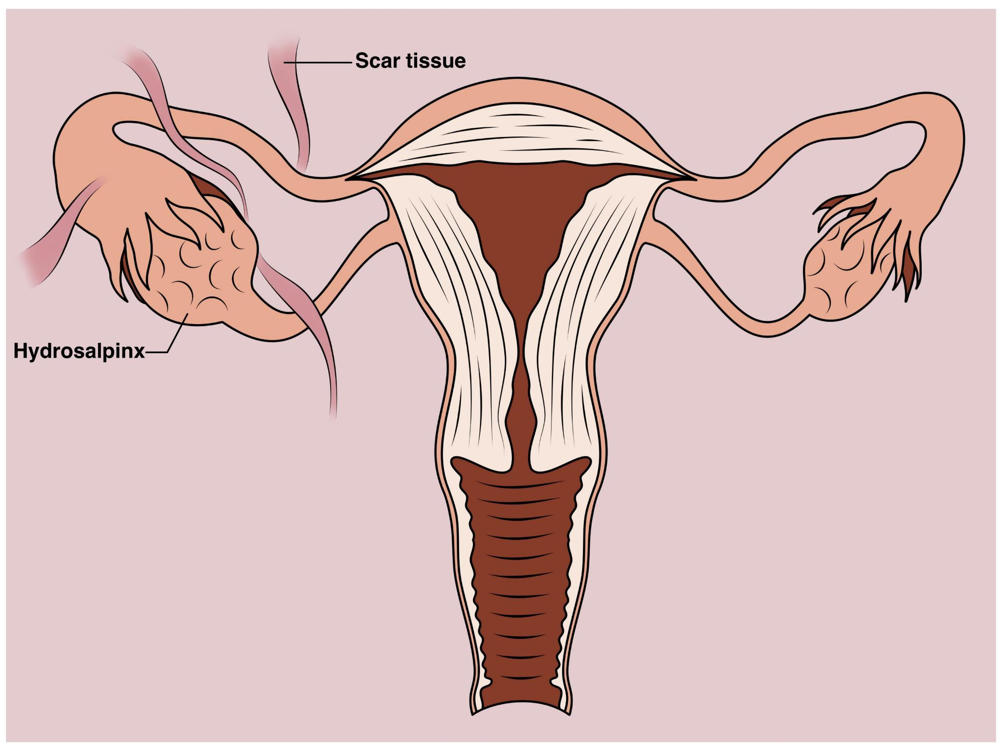
Scar Tissue

Slide 19
Uterine factor

Slide 20
Uterine Factor
Anatomic and Functional Abnormalities
Relatively uncommon cause of infertility
  Congenital malformations
  Leiomyomas
  Intrauterine adhesions
  Polyps?
  Chronic endometritis

Slide 21
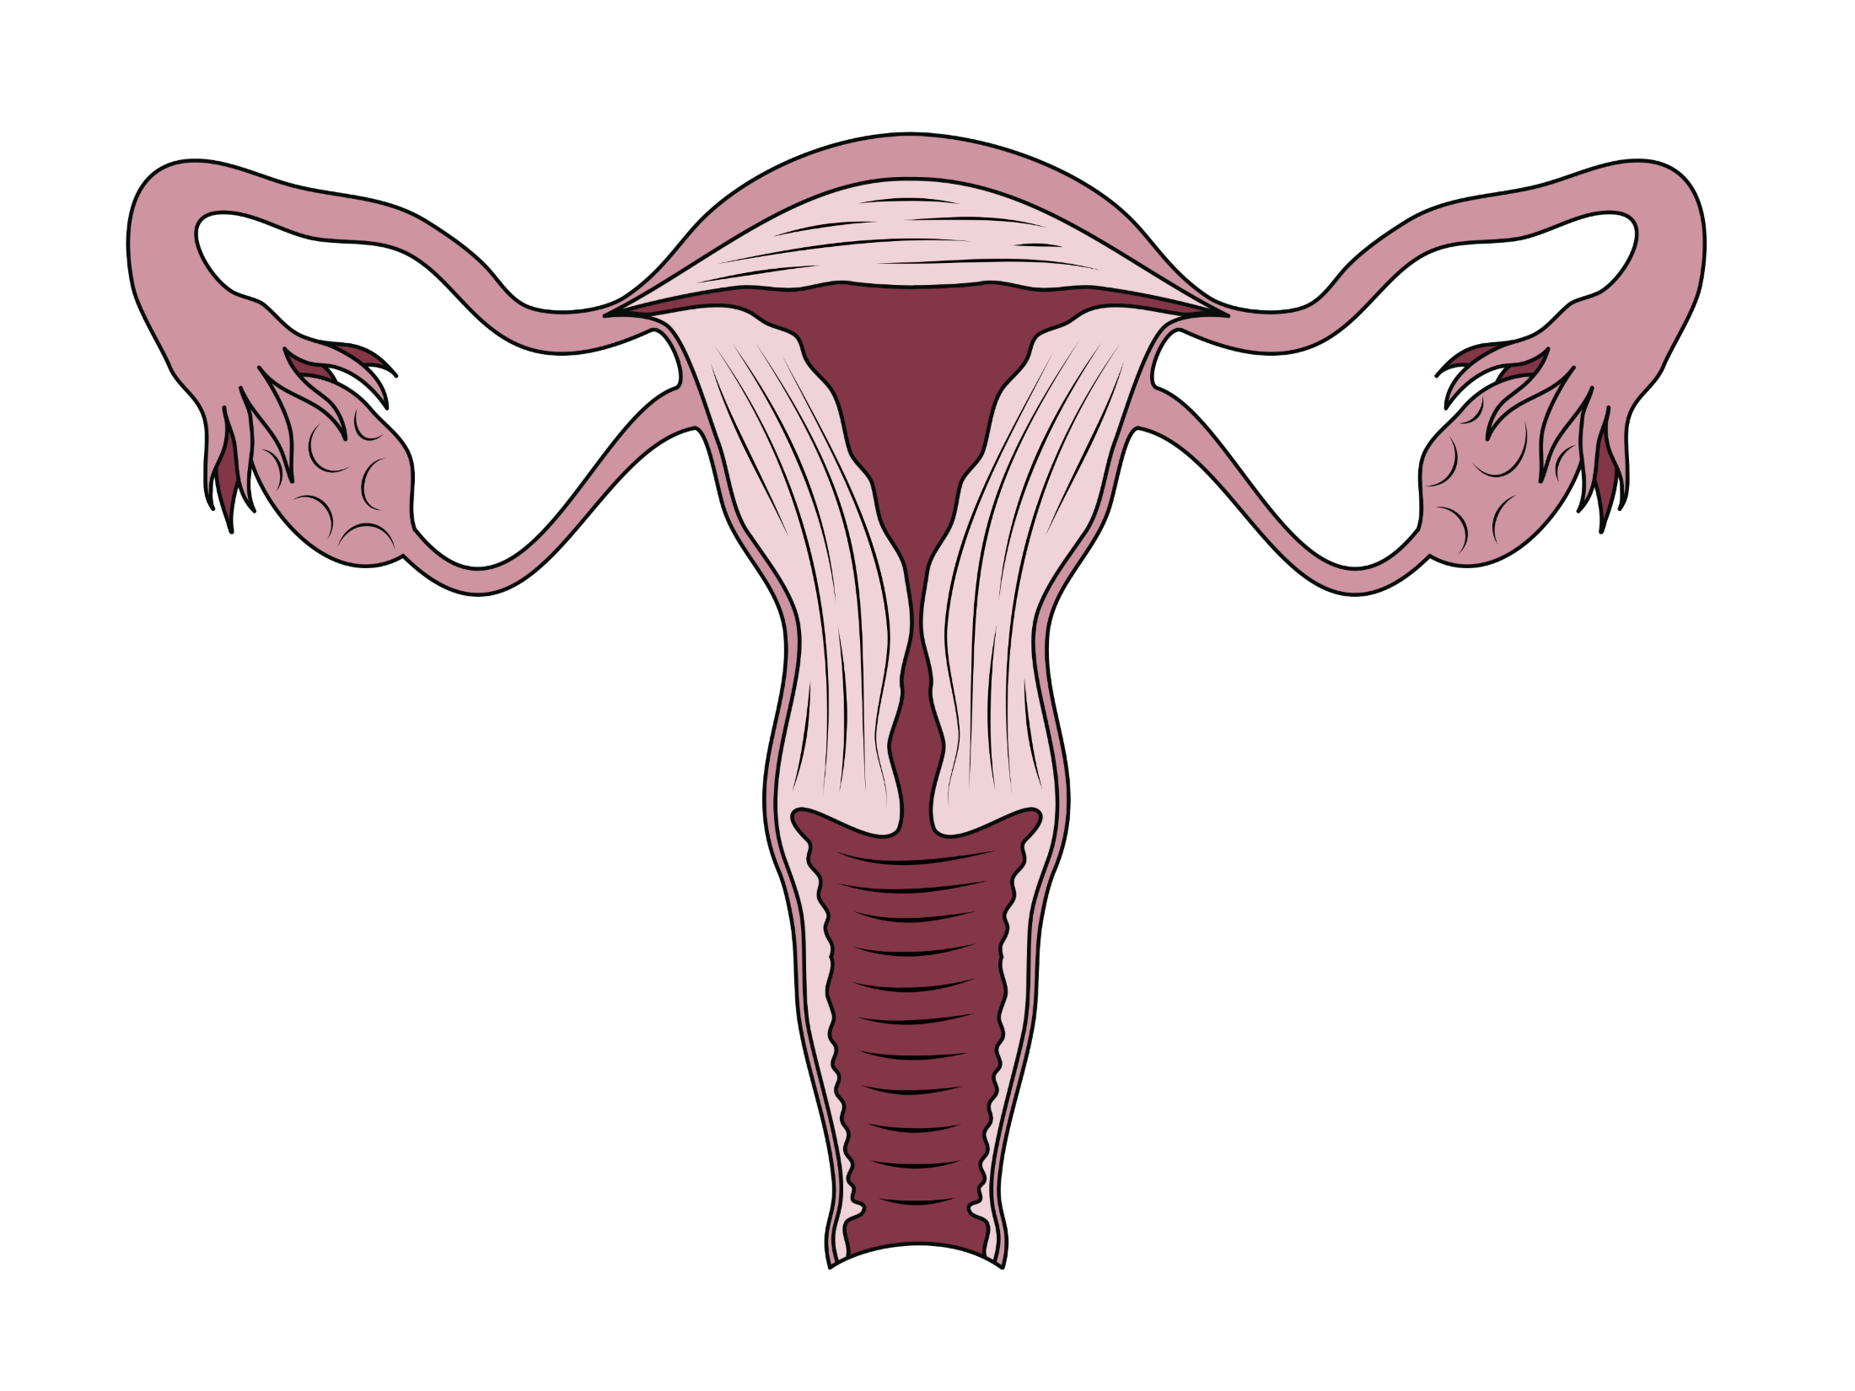

Slide 22
Congenital uterine anomalies

Slide 23
Congenital Uterine Anomalies
Associated with pregnancy loss and OB complications
Prevalence in infertile women is low, 2-4%
  Higher (10-15%) in women with RPL
Septate most common (35%) then bicornate (26%) arcuate (18%) and didelphys (8%).
  In septate uterus, live birth rates can be dramatically improved after surgery

Slide 24
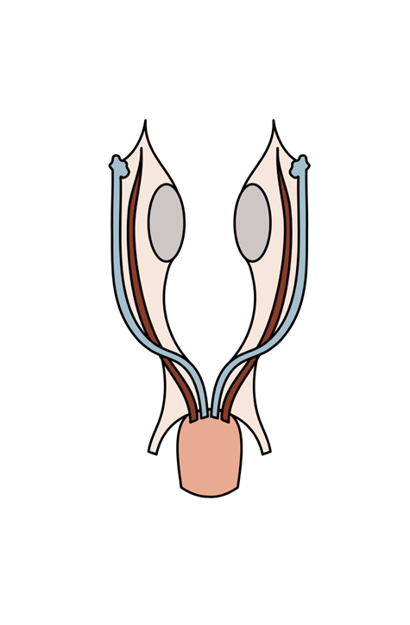
Uterine Development
At 5-6 weeks of development, both female and male embryos have 2 sets of paired genital ducts: mullerian and wolffian
  Genital system identical at this point. Development depends on presence or absence of Y chromosome

Slide 25
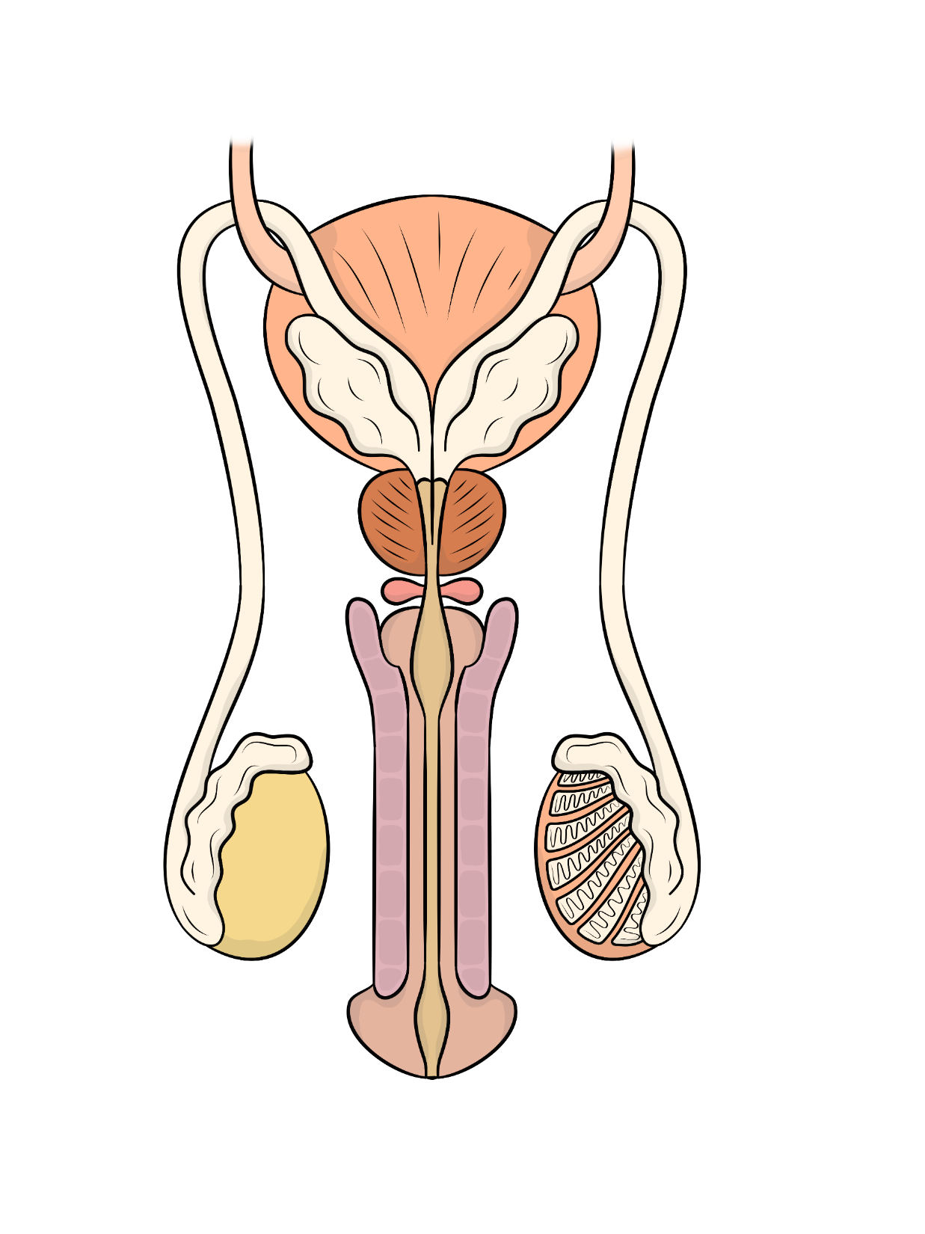

Slide 26

Notes:
At 5-6 weeks of development, both female and male embryos have 2 sets of paired genital ducts: mullerian and wolffian
Genital system identical at this point. Development depends on presence or absence of Y chromosome
Second image-9 weeks (disappearance of uterine septum
End of third month:
Newborn

Slide 27
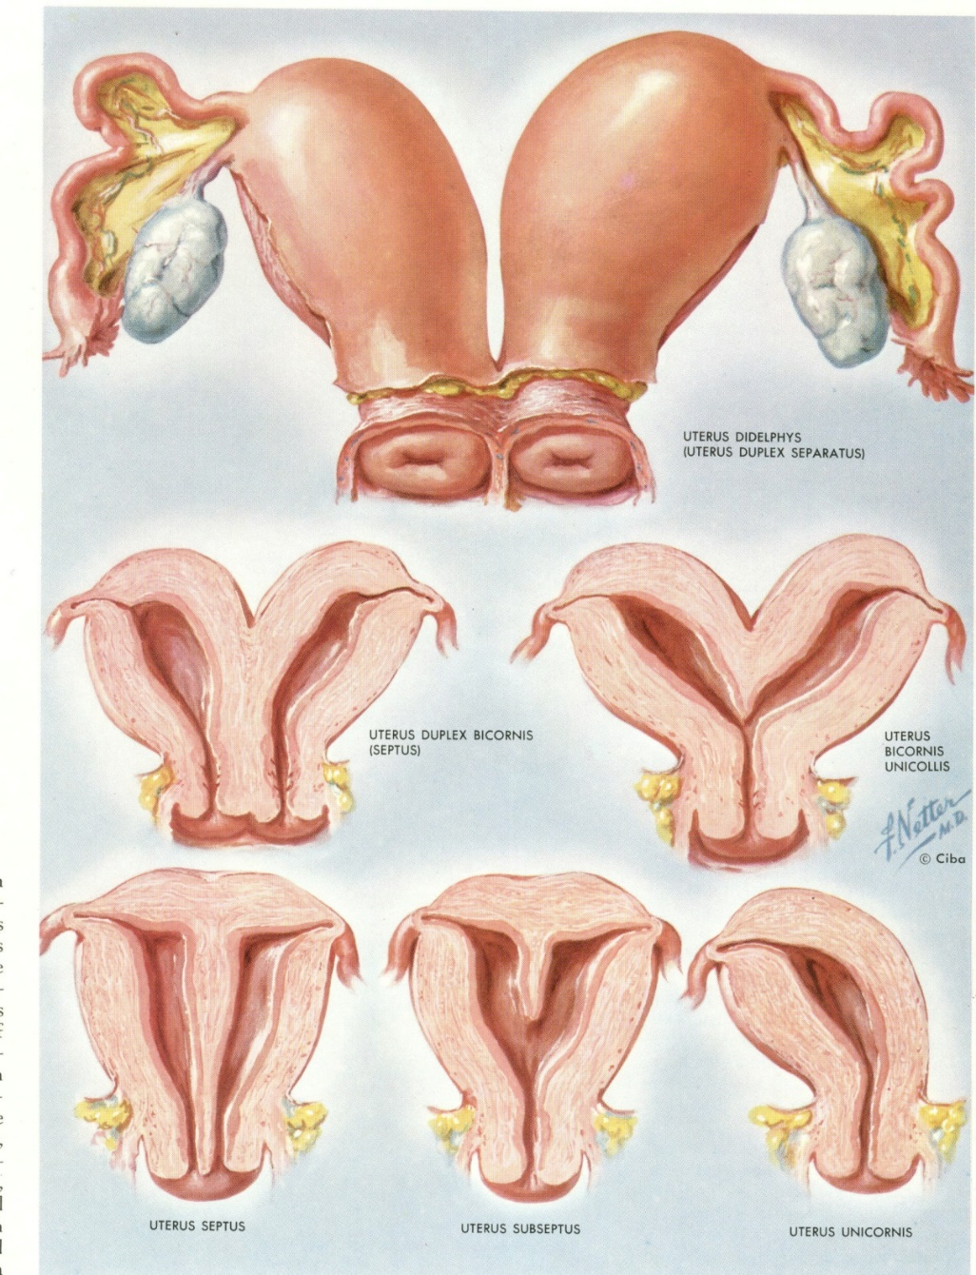

Slide 28
Uterine Septum
1-3% of all women
15% with renal anomaly
Term pregnancy 20-30 % when complete septum in place
Raga et al., Hum Reprod 1993

Slide 29
Acquired uterine abnormalites

Slide 30
Uterine Myomas
Found in 5-10% of infertile women
Cause of bleeding, pain and pressure, impact on fertility harder to define.
  Enlargement or deformity of the uterine cavity (inhibiting sperm or embryo transport)
  Obstruction of fallopian tubes
  Distorted adnexal anatomy
  Impaired uterine blood flow or chronic endometritis (interferes with implantation)
Submucosal fibroids most significant adverse effect on clinical pregnancy rates.
  Might reduce IVF rates by up to 70%

Slide 31
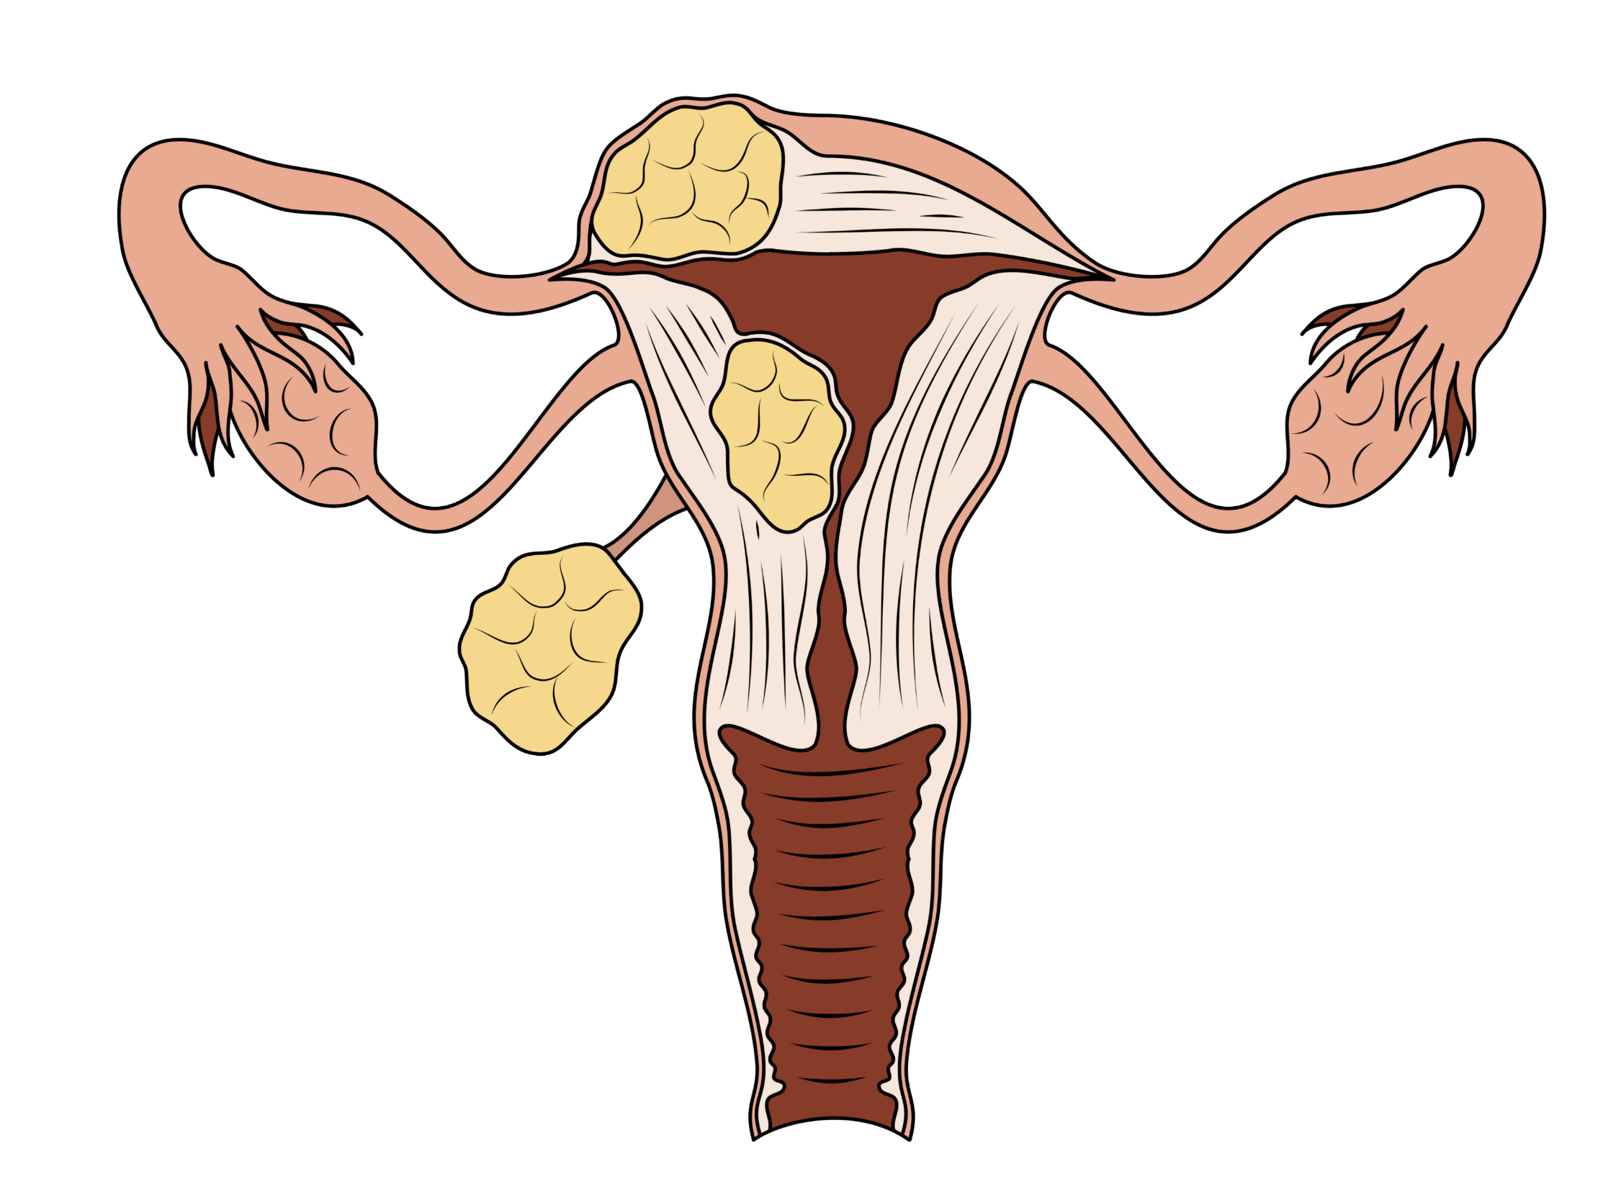

Slide 32
Asherman’s Syndrome
Intrauterine adhesions that result from trauma, inflammation and/or infection
Hysteroscopy best for dx and tx
  Misoprostol for cervical softening
  Adhesions are lysed
  Need physical barrier to keep uterine lining edges separated while healing
  Cyclic HRT to re-epithelialize lining and reduce risk of recurrent adhesions

Slide 33
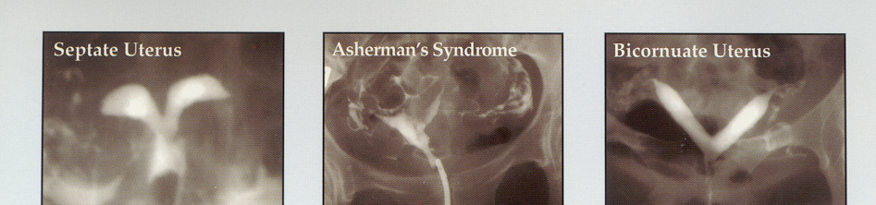
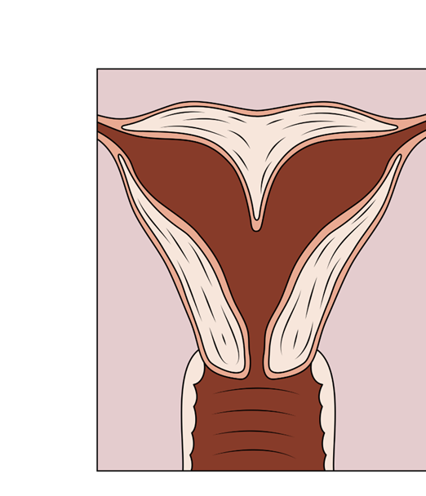
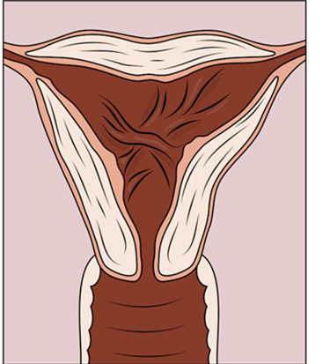
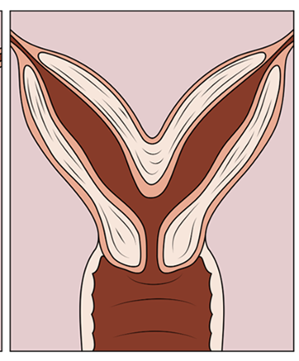

Slide 34
Endometrial Polyps
Endometrial growths
Increase in incidence with age
Prevalence in infertile women 3-10%
Polypectomy indicated when women symptomatic
Polypectomy may improve fertility depending on size of polyp

Slide 35
Chronic Endometritis
Chronic inflammation of the endometrium
  May hinder implantation
Associated with chlamydia and mycoplasma infections
  Chronic retained POC?
Diagnosis made histologically by doing endo bx
  Presence of plasma cells
Treated with antibiotics

Slide 36
Tubal factor

Slide 37
Tubal Factor
One of most common causes of infertility, found in approx. 30-35% of infertile women
H/o PID, septic abortion, ruptured appendix, tubal surgery or ectopic pregnancy suggestive of tubal damage
Distortion of tubal anatomy precludes sperm/egg interaction or oocyte capture

Slide 38
Treatment of Tubal Factor Infertility
IVF-treatment of choice if bilateral
  Unless religious, ethical or financial restrictions
Sterilization reversal
  Conception rates 45-82% after microsurgical reversal. Risk for ectopic higher
Distal tubal obstruction repair-separate and correct fimbria
  Results depend on severity of disease-if mild, consider surgery. If severe, IVF logical choice
Proximal tubal obstruction
  Segmental resection and anastomosis is surgical tx. Outcomes vary.

Slide 39
Hydrosalpinx
Substantial evidence that large hydrosalpinges adversely affect IVF outcome
Interference with implantation? Backflow of “toxic” substances.
In 2010, study showed that odds of achieving an ongoing pregnancy were twice as great after salpingectomy for hydrosalpinges before IVF compared to no intervention*.
  Laparoscopic tubal occlusion also improved rates
*Johnson, N, van Voorst, S et al. Cochrane Database Syst Rev: CD002125, 2010.

Slide 40


Slide 41
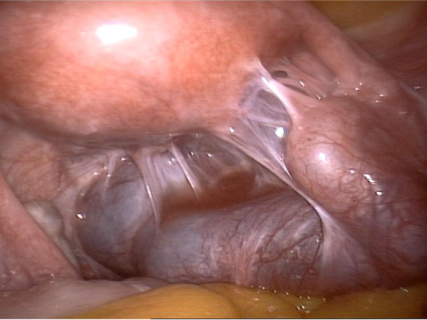
Fig. 1. Extensive adhesions due to chlamydial infection. The right tube is affected and
shows a massive hydrosalpinx
Picture from: H.-R. Tinneberg, A. Gasbarrini / International Journal of Gynecology and Obstetrics 123 (2013) S25–S30

Slide 42

Unexplained infertility

Slide 43
Unexplained Infertility
Incidence is 10-30%
Diagnosis of exclusion
Implies normal S/A, ovulatory function, normal uterine cavity and bilateral tubal patency
Might be subtle egg quality issue? Natural decline in fertility in female partner
Laparoscopy no longer routinely done
Treatments are empiric
Increase number of oocytes (superovulation) and correct timing of egg/sperm interaction (IUI or IVF)

Slide 44
Assisted Reproductive Technology
Both somewhat diagnostic and therapeutic for unexplained infertility
  Able to visualize sperm, oocytes and fertilization rate
Clearly most effective treatment for couples with unexplained infertility
  25-45% success rate
ART with PGS
  Most likely cause of unexplained infertility may relate to abnormalities in gametes or implantation

Slide 45
Fertility testing

Slide 46
ASRM Fertility Evaluation Guiding Principles
Timing and extent of evaluation depends on
  Patient age
  Duration of infertility
  Physical exam
  Medical history
  Patient’s wishes
Fertility and Sterility, June 2015 (103), e44-e50.
Notes:
The pace and extent of the patient’s evaluation will depend on several factors
Patient age
Duration of infertility
Results of the physical exam and medical history
Patient’s wishes (desire to accelerate treatment, for example)
Reference: Practice Committee of ASRM. Fertil Steril 2006;86(suppl 4):S264

Slide 47
History
Duration of infertility and results of any previous eval/tx
Menstrual history
Pregnancy history
Previous methods of contraception
Coital frequency and sexual dysfunction
Past surgery, procedures, previous hospitalizations, serious illnesses, PID or h/o STDs
Thyroid disease, galactorrhea, hirsutism, pelvic or abdominal pain, dyspareunia
Previous abnormal pap smears and any subsequent treatment
Current medications and allergies
Family history of birth defects, developmental delay, early menopause or reproductive problems
Occupation or exposure to known environmental hazards
Use of tobacco, alcohol, and recreational or illicit drugs
Fertil and Sterility, June 2015 (103), e44-e50.

Slide 48
Physical Exam
BMI, BP, pulse
Thyroid enlargement and presence of any nodules or tenderness
Breast characteristics and evaluation for secretions
Signs of androgen excess
Vaginal or cervical abnormality, secretions or discharge
Pelvic or abdominal tenderness, organ enlargement or masses
Uterine size, shape, position and mobility
Adnexal masses or tenderness
Cul de sac masses, tenderness or nodularity
Fertil and Sterility, June 2015 (103), e44-e50

Slide 49
Ovarian Reserve Testing
“Ovarian reserve” is a function of the number and quality of oocytes
1
Testing reflective of quantity; quality mostly influenced by age
Basal (day 2-4) FSH and estradiol and BAFC most commonly used
2
Low BAFC –total of 3-6 follicles
Single elevated FSH has predictive value*
Elevated basal FSH correlated with lower overall pregnancy rates, and at IVF fewer eggs retrieved at IVF & lower pregnancy rates
AMH levels <1 ng/ml have been associated with poor responses to stim, poor embryo quality, and poor pregnancy outcomes in IVF.
3
Fert and Ster 2015 (e44-e50).
Notes:
Ovarian reserve testing evaluates the functional capacity of the ovary; in other words, is the ovary capable of producing eggs?
Although numerous tests are available, the most commonly used tests are basal FSH and estradiol, done on day 2-4 of the menstrual cycle
A single elevated FSH has predictive value in terms of ovarian reserve
Reference: Toner JP, et al. Fertil Steril 1991;55:784

Slide 50
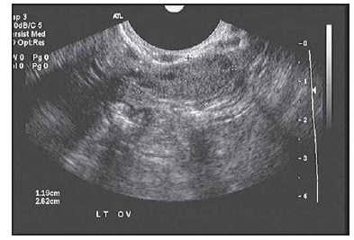

Slide 51
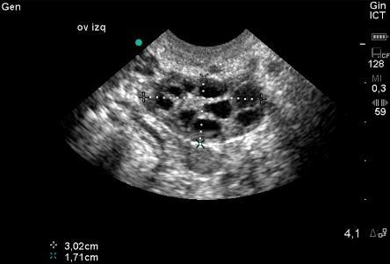

Slide 52
HSG
Standard method for evaluating tubal patency
  May offer a therapeutic benefit
  Tubal obstruction vs tubal/uterine contractions
Low sensitivity for uterine abnormalities
  50-75% sensitivity
Also can’t differentiate between some uterine abnormalities
  i.e. septate vs bicornuate uterus.
Laparoscopy with chromotubation (cervical injection of blue dye) can also demonstrate tubal patency
  Can correct abnormal findings during procedure
Tx with antibiotics (doxy 100 mg BID for 5 days starting 1-2 days prior to HSG) when tubal disease suspected, to decrease risk of acute salpingitis.

Slide 53
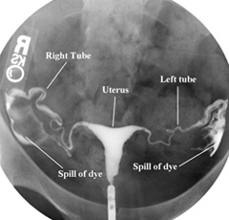
HSG
www.dallasivf.com

Slide 54
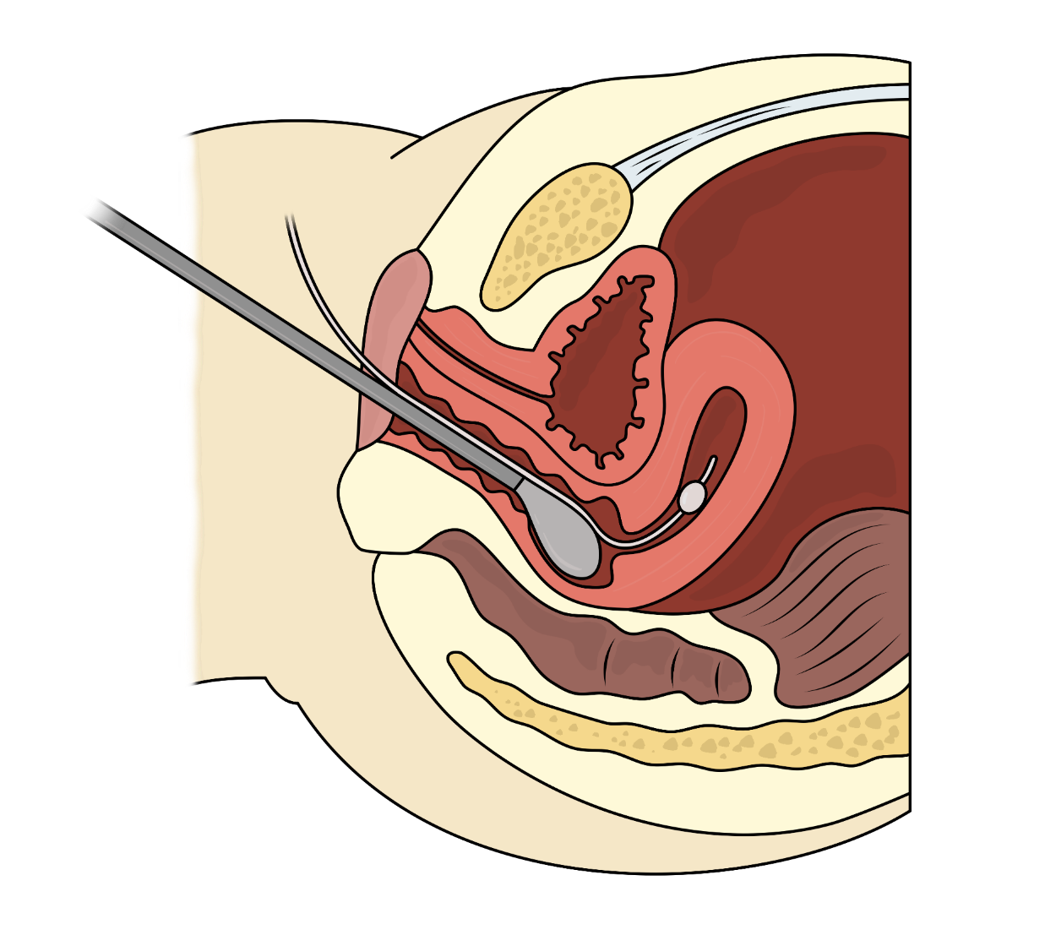
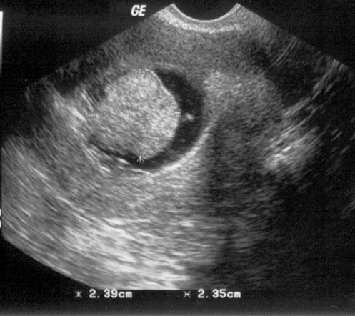
Saline Sonogram

Slide 55
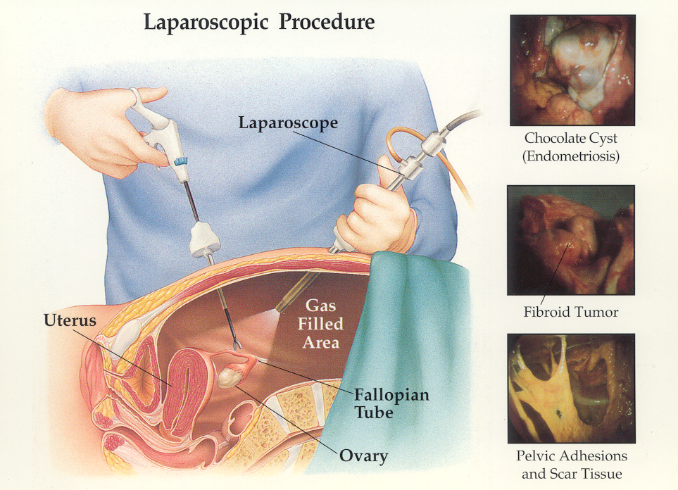

Slide 56
Conclusion
Infertility affects 10-15% of couples
Diagnosis, testing and treatment of infertility should be done systematically, taking into account patient age, duration of fertility and other pertinent factors (ethical and financial constraints).
The advances of ART have increased success rates in couples with unexplained fertility.

Slide 57
Question and answer section

Slide 58
Female Infertility Questions
In terms of female fertility, what three structures/organs needs to be functioning properly:
HPO Axis, Uterus, Ovaries/tubes
Name two of the most common causes of ovulatory infertility:
Hypothyroidism, Hyperprolactinemia, PCOS

Slide 59
When is the time in a woman’s life when she has the most eggs/follicles?
After what age do we see a rapid decline in egg quality?
The most common reason for the decrease in fertility potential and increase in miscarriage rate (with age) is: ___________.
What structure in the cytoplasm (as it ages) can contribute to a decrease in efficiency of cell division?

Slide 60
Name two ways that endometriosis can contribute to infertility?
What are three common treatments to manage endometriosis?
The best way to achieve pregnancy with stage 3-4 endometriosis is:

Slide 61
Congenital uterine anomalies are most associate with: Infertility or pregnancy loss (choose 1)
________________ fibroids have the most significant effect on clinical pregnancy rates
What is the name of the condition associated with uterine adhesions, most commonly as a result of uterine surgery/instrumentation?

Slide 62
A septate and a bicornuate uterus look similar on HSG, true or false?
A woman with a h/o chlamydia is more at risk for what 2 things?
The best way to achieve a pregnancy with a hydrosalpinx is with IVF, true or false?
The best test to look at the uterine cavity is:

Slide 63
What would you expect the clinician to do prior to HSG if he/she suspects that the patient has tubal disease?
How do you diagnose endometriosis?

