Slide 1
The HPO Axis/Menstrual Cycle Basics
Monica Moore, MSN, RNC
Fertile Health, LLC

Slide 2
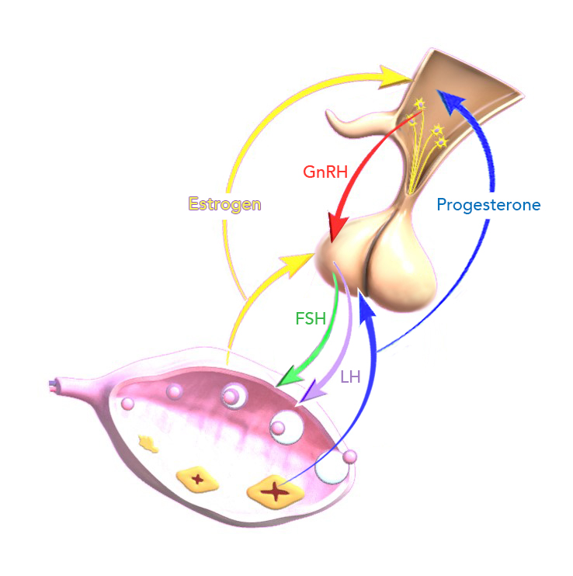
Objectives
Part 1: The normal hypothalamic-pituitary-ovarian axis (HPO Axis)
Distinguish the structures of the HPOA and describe how they interact as a feedback cycle
Discuss the major hormones involved in the HPOA

Slide 3
Objectives
Part 2: The Menstrual Cycle
Identify the major hormones of the menstrual cycle and describe their major functions
Explore the different phases of the menstrual cycle-ovarian and uterine

Slide 4
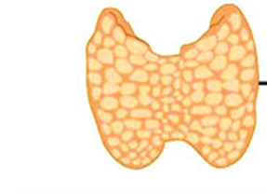
Objectives
Part 3: Female Fertility
Identify the basic principles of female fertility as they relate to the HPOA and menstrual cycle

Slide 5
Part 1: the HPO Axis

Slide 6
Hypothalamic-Pituitary-Ovarian Axis
Coordinated by system of feedback loops
Dependent upon the interaction of the hypothalamus, pituitary gland, and ovaries

Slide 7
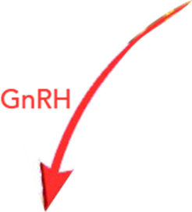
HPO Basics: The Hypothalamus
Drives the cycle
Secretes Gonadotropin Releasing Hormone (GnRH) in a pulsatile manner every 60-120 minutes
Altering the amplitude or frequency of the pulses can trigger negative or positive feedback
Also secretes TRH, CRH and other hormones (influences thyroid and adrenal function) and metabolic homeostasis.
CRH

Slide 8
HPO Basics: The Anterior Pituitary
Hypothalamus acts on anterior pituitary gland to secrete gonadotropins: follicle stimulating hormone (FSH) and luteinizing hormone (LH)
And TSH and PRL
PRL

Slide 9
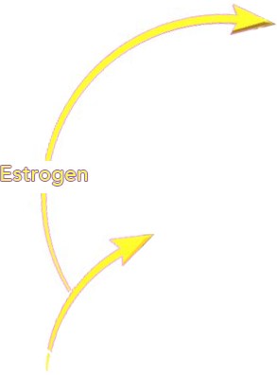
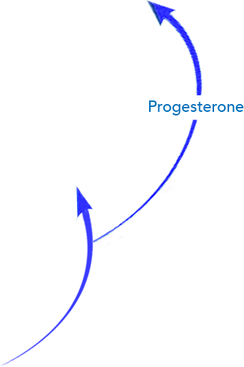
HPOA Basics
The anterior pituitary acts on the ovary to secrete estradiol and progesterone

Slide 10
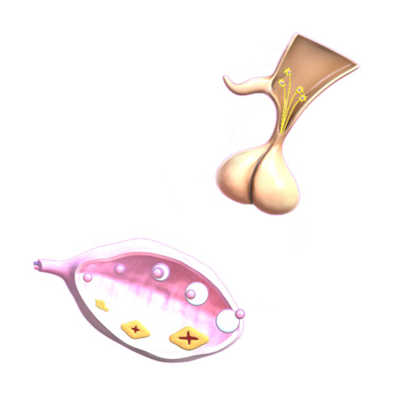
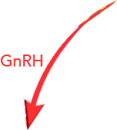

Slide 11
Hormones of the hpo axis

Slide 12
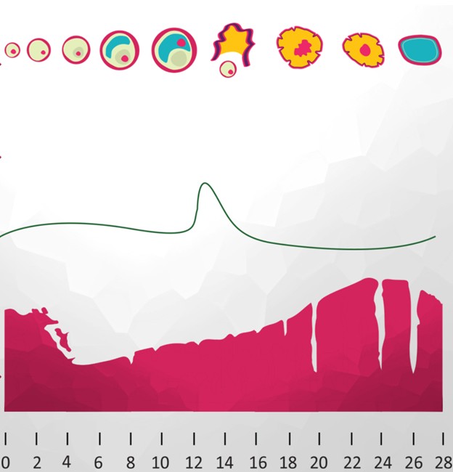
FSH
Stimulates the follicles to grow
Induces LH receptors on follicles
Increases estrogen and inhibin secretion

Slide 13
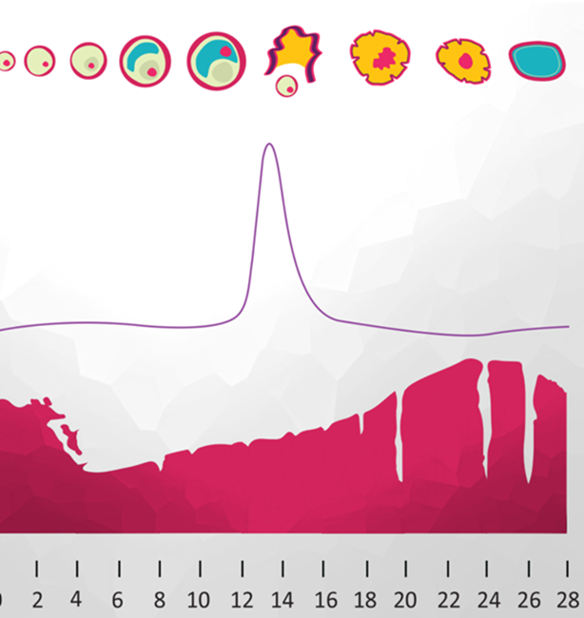
LH
Aids in follicular growth(Increases androgens)
Causes ovulation to occur
Sustained E2 levels-change to positive feedback
Causes the Corpus Luteum to secrete progesterone
Activates and matures eggs that are “frozen” in Meiosis 1

Slide 14
Ovulation in Relation to LH Surge
10-12 hours after LH peak
24-36 hours after E2 peak
Ovulation occurs:

Slide 15
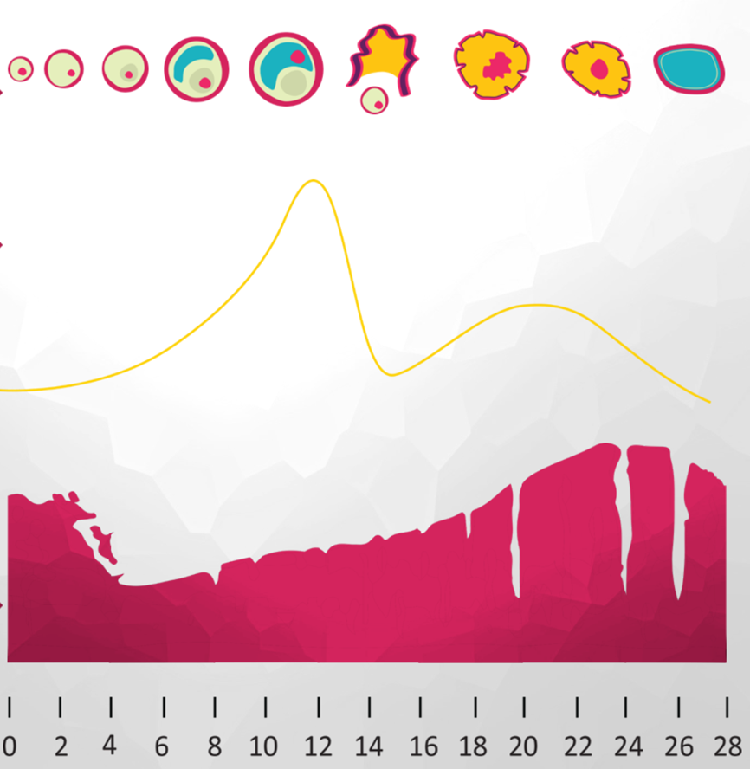
Estrogen
Estrogen is made by the granulosa cells in the follicle
Causes the lining of the uterus to grow
Feeds back to the Hypo and Pituitary to regulate GnRH, FSH and LH secretion
Stops menstrual bleeding
Notes:
11
Opportunities in COS

Slide 16
Ovarian Follicles
Ovarian follicles found in the cortex (outer part of ovary).

Slide 17
Ovarian Follicles
Each follicle consists of an oocyte surrounded by layers of granulosa and theca cells
Dominant follicle acquires highest concentration of FSH receptors

Slide 18
Estrogen Production

Slide 20
Peak E2
E2>150 to 250 pg/ml> 36 hours results in LH surge
Notes:
Ovulation occurs 18 hours after gonadotropin peak

Slide 21
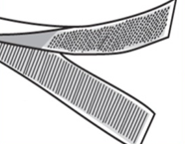
Progesterone
Progesterone is made by the Corpus Luteum
Feeds back to Hypo and Pit to regulate GnRH, FSH and LH secretion
Is secreted in small amounts by growing follicle
Stops the growth of the endometrium and causes it to secrete substances to support an early pregnancy
Notes:
11
Opportunities in COS
This image is designed to introduce the concept of the Two Cell Theory and the interaction of Granulosa and Theca cells within the follicle. Positioning of the oocyte and cumulus oophorus is also represented.

Slide 22
P4 Relative to Initiation of LH Surge
1 @ 24 hours
3 @ 48 hours
0.3 at surge

Slide 23
Part 2: Menstrual Cycle basics

Slide 24
Menstrual Cycle Basic Terms
Normal Values:
Duration: 28 +/- 7d
Amenorrhea
Oligomenorrhea
Intervals >35 days
Polymenorrhea
Intervals < 21 days

Slide 25
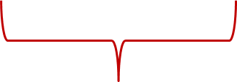
Phases of Menstrual Cycle
Follicular
Luteal
Proliferative
Secretory

Slide 26
Menstrual Cycle Basics
Follicular phase is variable
Corpus Luteum has a finite lifespan (14d) unless rescued by hCG
E and P start to drop 7d prior to menses
Menses starts about 3d after P <1 ng/ml

Slide 27
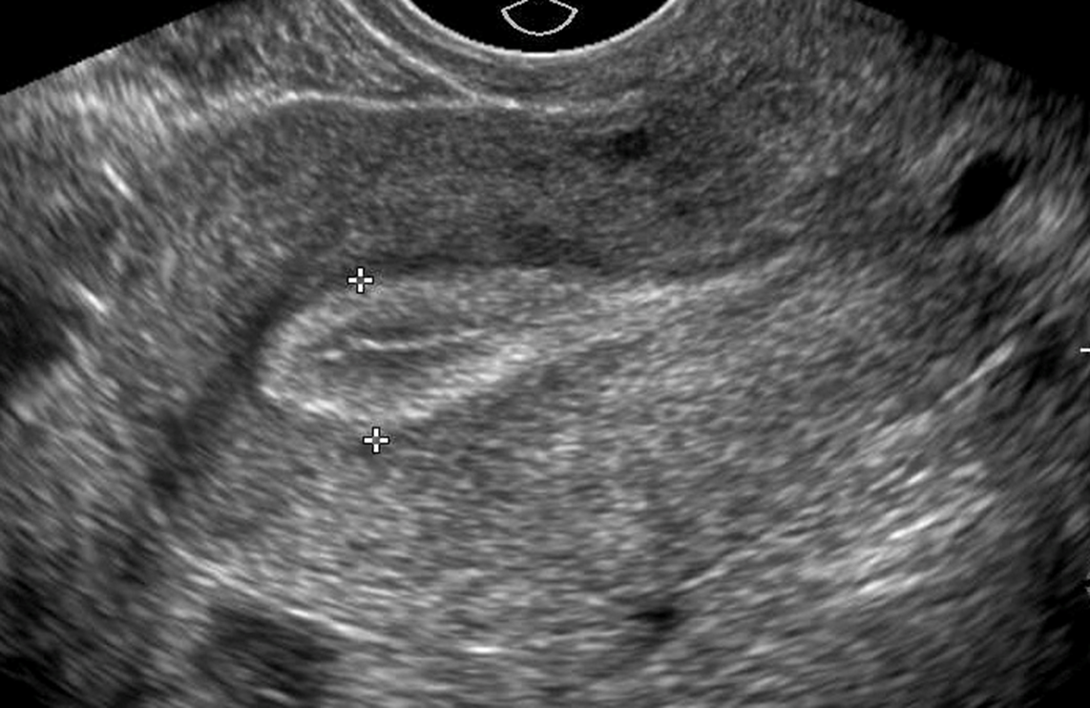
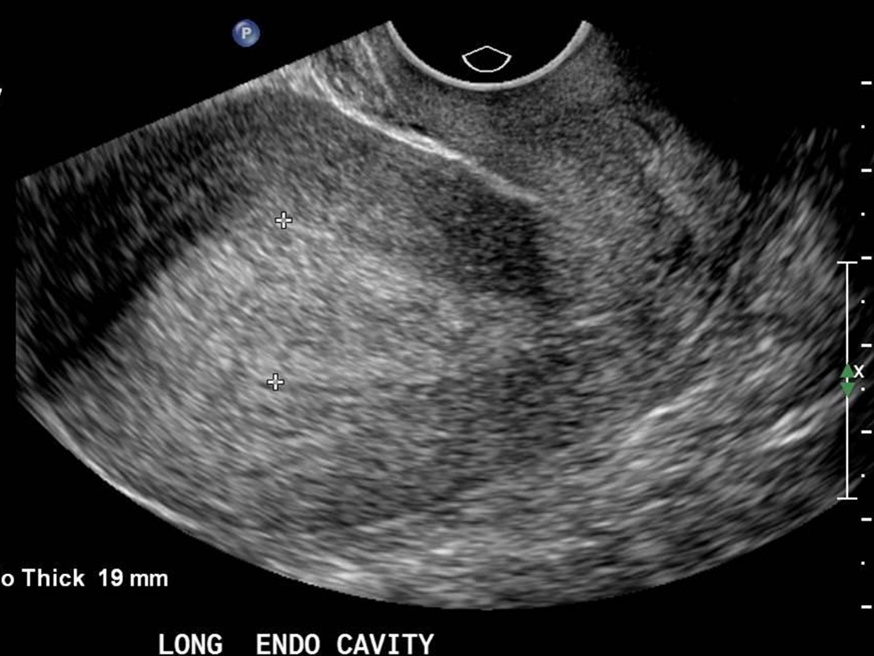
Uterine Phases
Proliferative
Secretory

Slide 28
Ovarian and Uterine Events are Highly Synchronized

Slide 29
Window of Receptivity
In a natural cycle, ovary and uterus in synchrony, so need to replicate this in stimulated cycle.
It closes prematurely if:
Endogenous P4 is elevated at trigger
Exogenous P4 is given too early
Timing of P4 “starts the clock” and can alter the window

Slide 30
Part 3: Female fertility: basic principles

Slide 31
Female Fertility: Basic Principles
HPO Axis needs to be functioning properly
Uterus needs to be receptive to hormonal stimulation and implantation.
Cervix needs to allow the entry of sperm
Ovaries need to have viable follicles that respond to hormonal stimulation and ovulate

Slide 32
The Infertility Evaluation
Menstrual history
Day 3 FSH, LH and E2 (normal levels depend on lab assay)
E2<70
FSH<10
LH<10
Luteal Prog level?
Evaluation of uterine cavity

Slide 33
Luteal Phase Defect
How do you determine this?
Low luteal progesterone levels?
Endometrial biopsy
Histology results are subjective
Gives limited information i.e. dating of endometrium, but receptivity is only implied

Slide 34
Principles of Superovulation
In gonadotropin-treated cycles:
Small (<10 mm) follicles need constant, exogenous FSH in order to grow and mature
FSH levels rise and stay elevated until trigger shot
Once follicles reach 10-12 mm, granulosa cells become receptive to LH stimulation
Maturing follicle may become less dependent on FSH at this point
*Stanger, et al, 1985; Howles et al, 1986; Regan, et al, 1990
Notes:
Should exogenous LH be added at this point?
In early 1980s and 90’s, LH linked to premature luteinization, and reduced oocyte and embryo quality*
High endogenous follicular LH levels in PCOS patients maybe to blame

Slide 35
Nursing Considerations
The fact that a woman has regular cycles has no bearing on her ovarian reserve and her risk for aneuploidy.

Slide 36
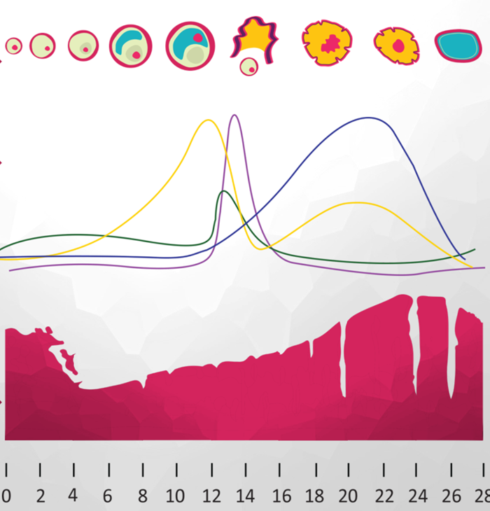
Day 10-12
“Midcycle”
E>150 (unless femara)
P<3
LH<15
Day 2-4
E2<85
P<2.5
bHCG<5
Day 19-21
“luteal levels”
E>120
P>12
Mature follicle=20 mm (but ≥ 15 mm responds to trigger shot.
Endo lining ≤ 5 mm
Endo lining ≥ 7 mm
Type 1-2 (trilaminar)
Notes:
Ovulation occurs 18 hours after gonadotropin peak

Slide 37
A word about amh

Slide 38
AMH
Anti-Mullerian Hormone (AMH) or Mullerian Inhibiting Substance (MIS)
What does it do?
Primary role: regression of mullerian ducts in male fetus
AMH expression is produced by ovarian granulosa cells
AMH levels are predictive of ovarian response
Higher = better
Lower = worse (opposite of FSH)
Cycle Independent
No need to draw on certain cycle days

Slide 39
How Do We Counsel Pt’s?
AMH Level | Ovarian Reserve? | Implications for Pt:
0.1-0.3 | Severe DOR | Treat as if FSH>14
0.3-1.0 | Gray Range | Treat As if FSH ≈10-13
1.0-3.5 | Normal | Treat as if FSH <10
>3.5 | PCOS? | OHSS precautions

Slide 40
Conclusion
The hormones produced by a normally functioning hypothalamic-pituitary-ovarian axis (HPO Axis) interact in a feedback cycle.
The menstrual cycle is a result of ovarian and uterine synchrony
When there is a disruption in the HPO axis, it can result in ovulatory dysfunction.

Slide 41
Question and Answer Session

Slide 42
Q & A
In the early follicular phase, which hormone is responsible for follicular growth?
Estrogen
Progesterone
LH
FSH

Slide 43
Q & A
Keeping in mind the 2 cell theory, LH acts on which cells to produce androgens as a substrate for estrogen formation?
Sertoli
Granulosa
Theca
Leydig

Slide 44
Q & A
Which of the following hormones provide feedback to the pituitary to decrease FSH secretion?
GnRH
LH
Estrogen
Inhibin

Slide 45
Q & A
What is the name of the process by which androgens get converted to estrogen in the ovary?
Aromatization

Slide 46
Q & A
The secretory phase of the endometrium is dominated by the presence of which hormone?
Progesterone
What is the name of the hormone that “rescues” the corpus luteum?
hCG

Slide 47
Q & A
Which of the following is NOT true about AMH?
It is responsible for the regression of the Mullerian ducts in XY males
It is elevated in women with PCOS
It should be checked on day 3 with the FSH level
It is made by small, antral follicles

